Slide 1

VOCO – Native Language Learning Platform
Project Management, Software Design, Refactoring and Implementation
L.J. School of Computer Application | L.J. University
PROJECT TEAM
Meet Patel
Yash Shah
Krishna Radhani
PROJECT GUIDE Prof. Rita Gokani
Notes:
Presenter: Krishna Radhani. Introduce VOCO, the three roles and the guide. Takeaway: a MERN-based native-language learning platform built over Aug-Oct 2026 using Scrum.

Slide 2
Team Roles & Contributions
Meet Patel
Yash Shah
Krishna Radhani
BACKEND • DATABASE • TEAM LEAD
FRONTEND • AI INTEGRATION
DOCUMENTATION • QA • UI/UX
• Team Manager / Scrum Master
• Jira epics: VOCO-1, VOCO-2, VOCO-3
• Authentication, exams, progress and APIs
• Refactoring: REFACTOR-001–004
• React.js frontend development
• Jira epics: VOCO-4, VOCO-5
• Speech-to-Text, AI response and Text-to-Speech
• Routing, dashboard and UI pages
• Project documentation
• Testing and Quality Assurance
• UI/UX design
• Jira epic: VOCO-6; code-smell identification and test reports
VOCO • Project team responsibilities
2
Notes:
Presenter: Krishna. Use the Human Resource Plan (Sec 3.1.10) and Jira assignees. Meet = Scrum Master/project lead in Jira and owner of epics VOCO-1/2/3; Yash = VOCO-4/5; Krishna = VOCO-6. Takeaway: clear role ownership.

Slide 3
Problem Definition and Motivation
Aa
अ
The problem (report Sec 1.4)
Classroom and printed-material dependence
Costly; geographic and financial limits
Fixed schedules
Limited personal attention and delayed feedback
Few chances for consistent conversation practice
Progress is tracked manually by instructors
Why we built VOCO
Anytime, anywhere web access
Self-paced vocabulary, videos and MCQs
Automated scoring and progress tracking
AI voice conversation practice
Admin-managed content per language
अ
3
Notes:
Presenter: Krishna. Stay with Sec 1.4 and 1.3. Takeaway: traditional learning is costly, fixed-schedule and gives limited personal feedback, so VOCO is web-based, self-paced and trackable.

Slide 4
Objectives, Existing vs Proposed System
Aa
अ
Objectives
Accessible learning
Structured vocabulary content
Automated assessments
Progress tracking
AI speech-to-speech practice
Existing system
Classroom and in-person
Printed books and worksheets
Role-plays and group practice
Manual tests by instructors
Proposed VOCO
Implemented: OTP + JWT auth, languages, chapters, words, TTS, videos, MCQs, chapter and final exams, progress, certificate, admin, STT-AI-TTS pipeline
Planned: pronunciation feedback, personalization, analytics
Aa
4
Notes:
Presenter: Krishna. Separate what is implemented (Jira Done, Sprints 1-12) from what the report marks as planned. Takeaway: do not claim pronunciation feedback or personalization as built.

Slide 5
Project Charter and Planning
Aa
अ
Scope and team
3 members; 1 Aug – 31 Oct 2026
Stakeholders: learners, admin, team, guide, university
Deliverables: web app, UML design, test report, refactoring log
Tech and quality targets
React.js, Node.js, Express.js, MongoDB
VS Code, GitHub, Postman
Targets: JWT auth, hashed passwords, input validation, <3 s page response
અ
Initiation
Aug 2026
Design
Aug 2026
Development
Sep 2026
Testing and QA
Oct 2026
Docs and Submission
Oct 2026
5
Notes:
Presenter: Meet Patel (project manager). Cover Sec 3.1: dates 1 Aug-31 Oct 2026, scope, stakeholders, quality targets (99% uptime, <3 s response are charter targets, not measured results). Note: charter text also mentions a 6-month assumption; the schedule itself is 3 months.

Slide 6
Lifecycle Model – Scrum
Aa
अ
Requirements
Sprint Planning
Development
Testing
Review
Improvement
How we ran it
12 sprints of 7–10 days, 1 Aug – 31 Oct 2026
Capacity: 3 members × 5 days = 15 person-days (sprint plan)
Work split across frontend, backend, DB and AI by Jira assignee
Review and unfinished work
Epics VOCO-1 to 6 on a Scrum board: To Do, In Progress, In Review, Done
Status reports SR-001 to SR-003 each month
Sprint 12: VOCO-54 left To Do; 4 change requests approved (AI feature, STT, TTS, feedback)
अ
6
Notes:
Presenter: Meet. 12 sprints are in the Sprint Backlog (3.6). Sprint 12 is still Planned: only final testing and deployment (VOCO-54, 5 SP) remained To Do. Note: Jira config says sprints are approx. 4 weeks while the backlog shows 7-10 day sprints; use the backlog dates.

Slide 7
Work Breakdown Structure
Aa
अ
1.0 Initiation
Proposal, requirements, feasibility
2.0 Planning
Charter, Scrum, quality and change plans
3.0 Analysis and Design
Use case, architecture, DB, UML, UI/UX
4.0 Development
Auth + OTP + JWT, learning, videos, MCQ/exams, progress + certificate, admin
5.0 Testing and QA
Functional, integration, UAT, security
6.0 Deployment
Production config, deploy, final test
7.0 Closure
Report, demo, submission
Aa
7
Notes:
Presenter: Meet. Mirror Sec 3.3 (WBS 0.0 to 7.0). Takeaway: Application Development is split by module and each module maps to Jira epics.

Slide 8
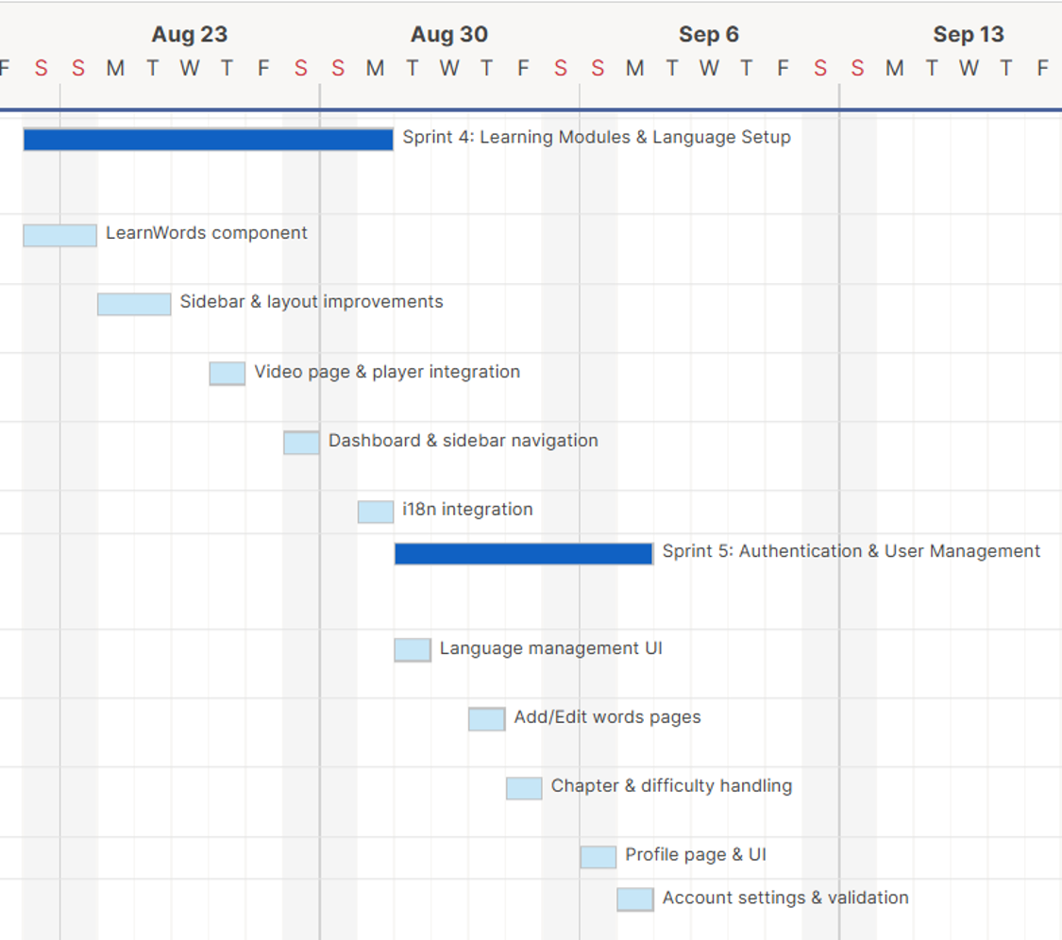
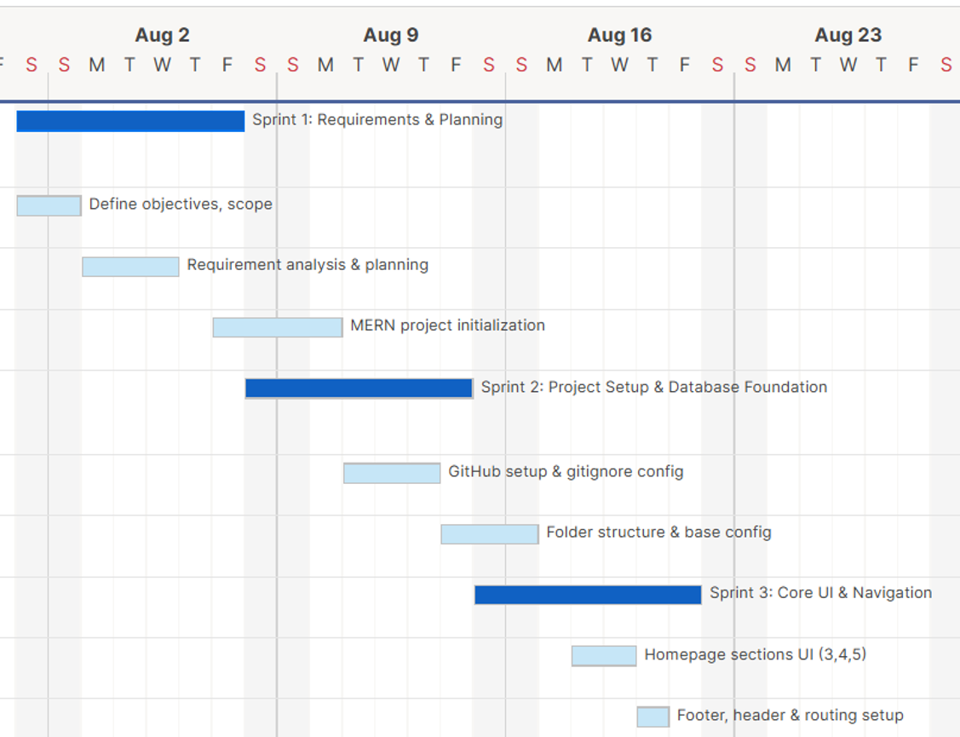
Project Schedule (Gantt) – Sprints 1–5
Aa
अ
અ
Aug 1 – Sep 7, 2026: requirements, setup, core UI, learning modules, auth
8
Notes:
Presenter: Meet. Original Gantt exports (Sec 3.5). Dark bars are sprints, light bars are tasks.

Slide 9
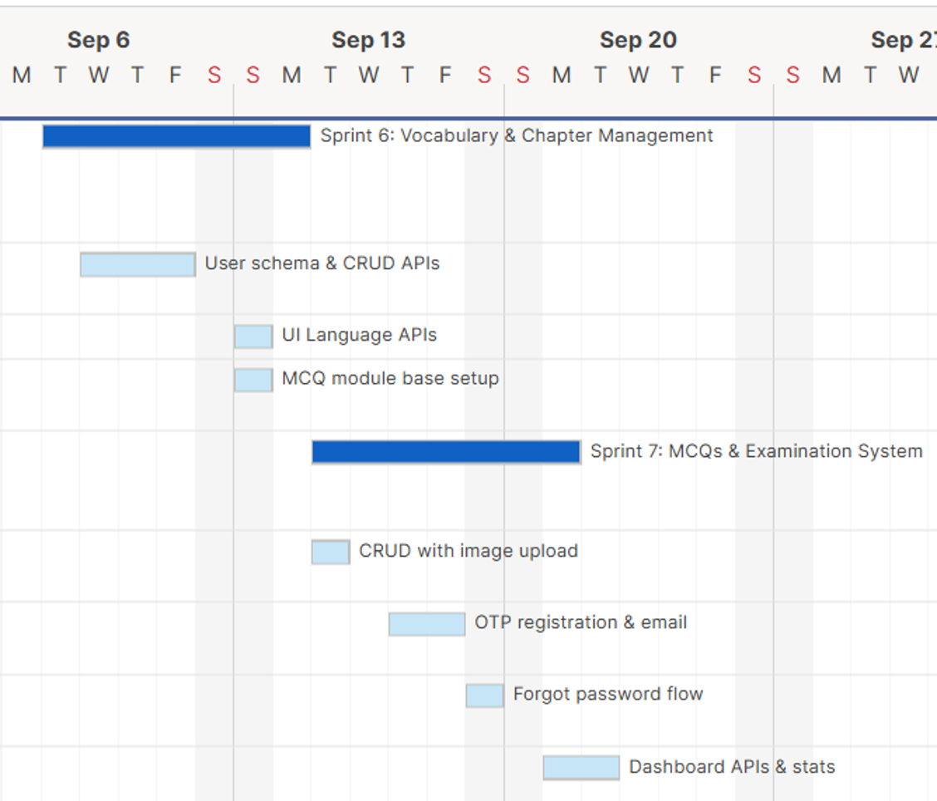
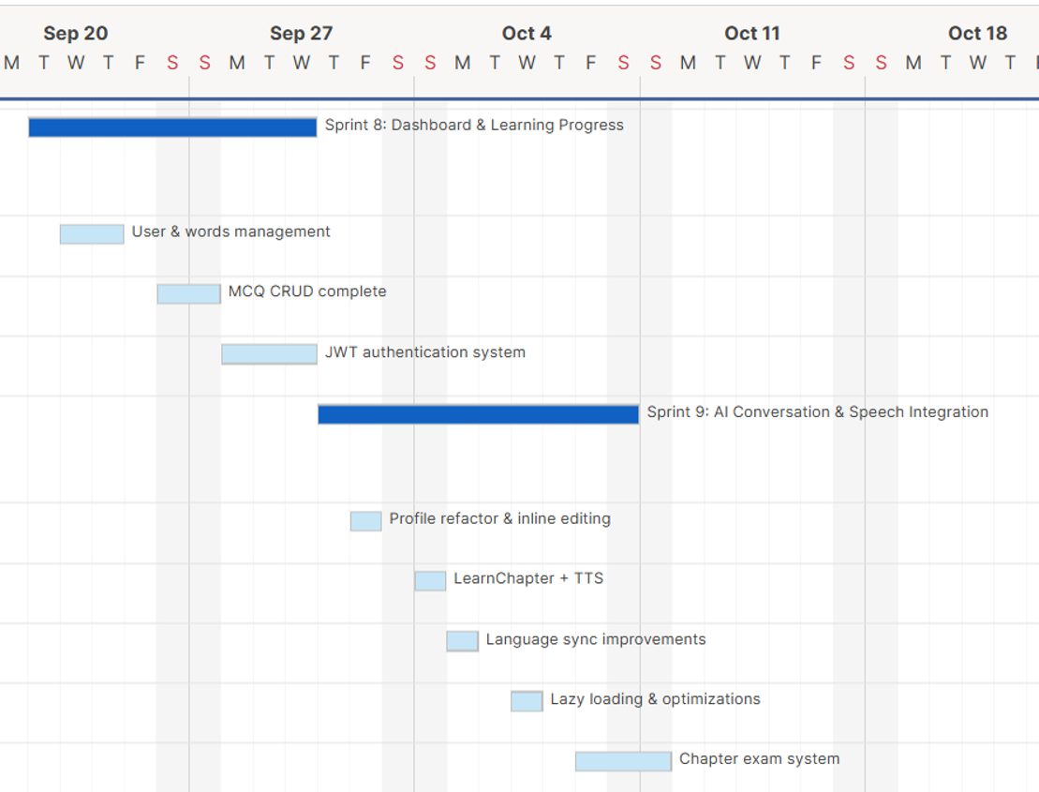
Project Schedule (Gantt) – Sprints 6–9
Aa
अ
अ
Sep 8 – Oct 10, 2026: vocabulary, MCQs and exams, JWT, AI speech integration
9
Notes:
Presenter: Meet. Original Gantt exports (Sec 3.5).

Slide 10
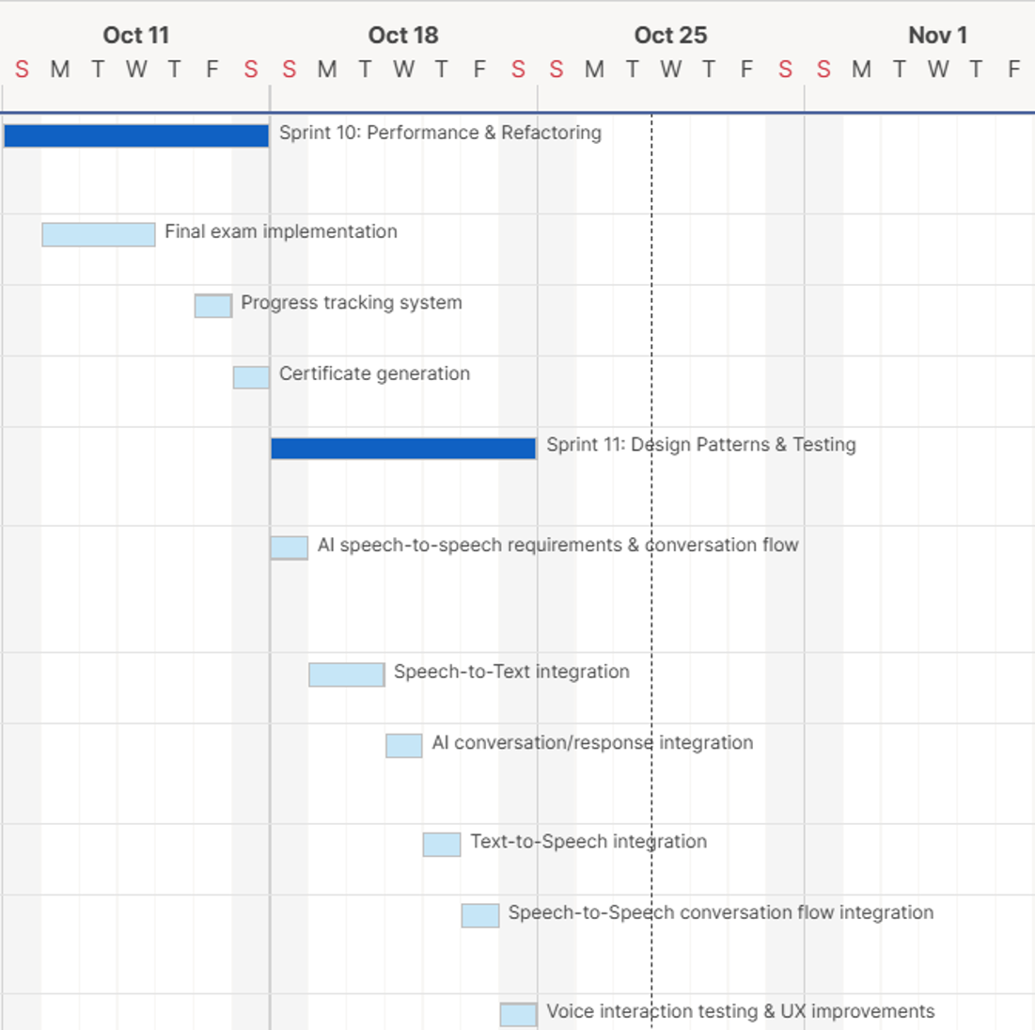
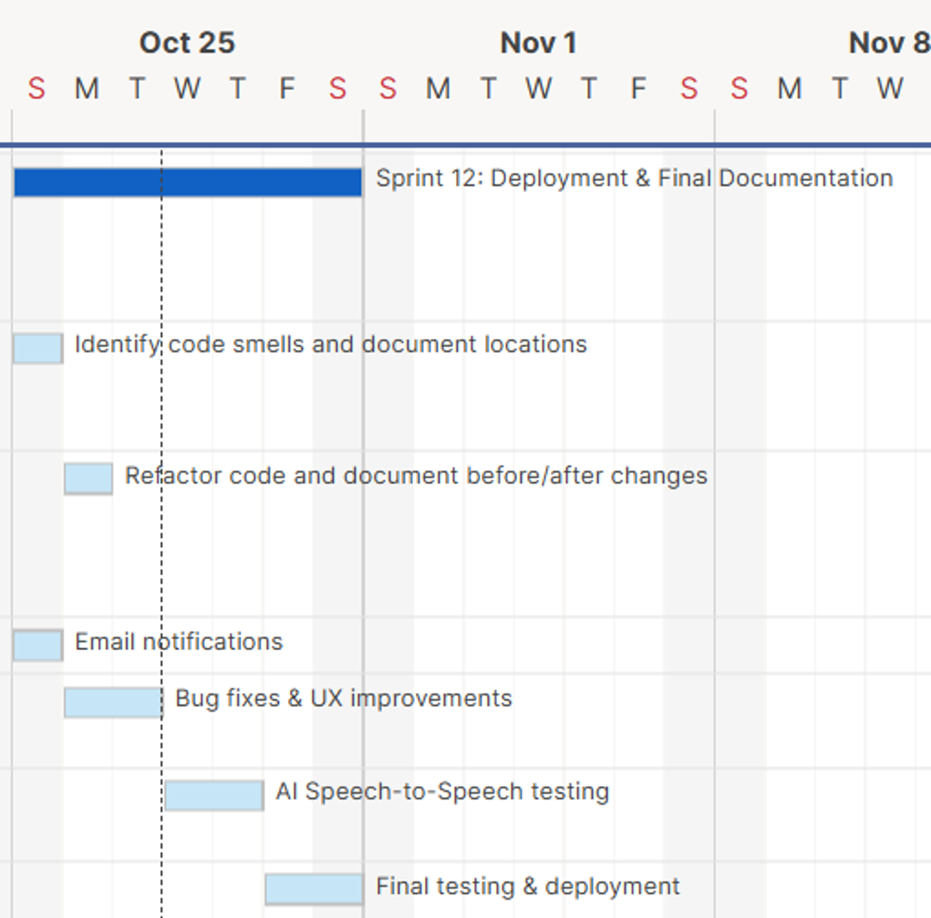
Project Schedule (Gantt) – Sprints 10–12
Aa
अ
Aa
Oct 11 – Oct 31, 2026: refactoring, patterns, testing, final docs and deployment
10
Notes:
Presenter: Meet. Original Gantt exports (Sec 3.5). Dashed line marks the report date; Sprint 12 final testing and deployment is still planned.

Slide 11
Risk Register
Aa
अ
ID | Risk | P / I | Score | Owner | Status
R-001 | Requirements change | M / H | 6 | Proj. Manager | Monitoring
R-002 | Technical issues delay MERN dev | M / M | 4 | Backend/Frontend | Monitoring
R-003 | DB errors or data loss | L / H | 3 | DB Integration | Open
R-004 | Auth / security vulnerabilities | M / H | 6 | Backend | Monitoring
R-005 | AI STT-AI-TTS unreliable | M / H | 6 | Backend | Open
R-006 | Speech or accent misrecognised | M / H | 6 | Backend | Open
R-007 | Unsuitable AI responses | M / H | 6 | Backend | Open
R-008 | Speech latency | M / M | 4 | Backend | Open
R-009 | Testing and bug fixing overrun | M / H | 6 | QA | Monitoring
R-010 | Deployment delay | L / H | 3 | Proj. Manager | Open
अ
Technical risks
Mitigation & monitoring
• Speech/transcription errors • API/database defects
• Authentication and input-validation gaps
• Test STT/AI/TTS; validate inputs and protect credentials
• Track Jira issues; prioritize and re-test defects
11
Notes:
Presenter: Meet. Sec 3.9. All 10 risks use Mitigate; no completion of mitigation is claimed in the report. R-003, R-005 to R-008, R-010 remain Open. The charter also lists browser compatibility (Low/Medium).

Slide 12
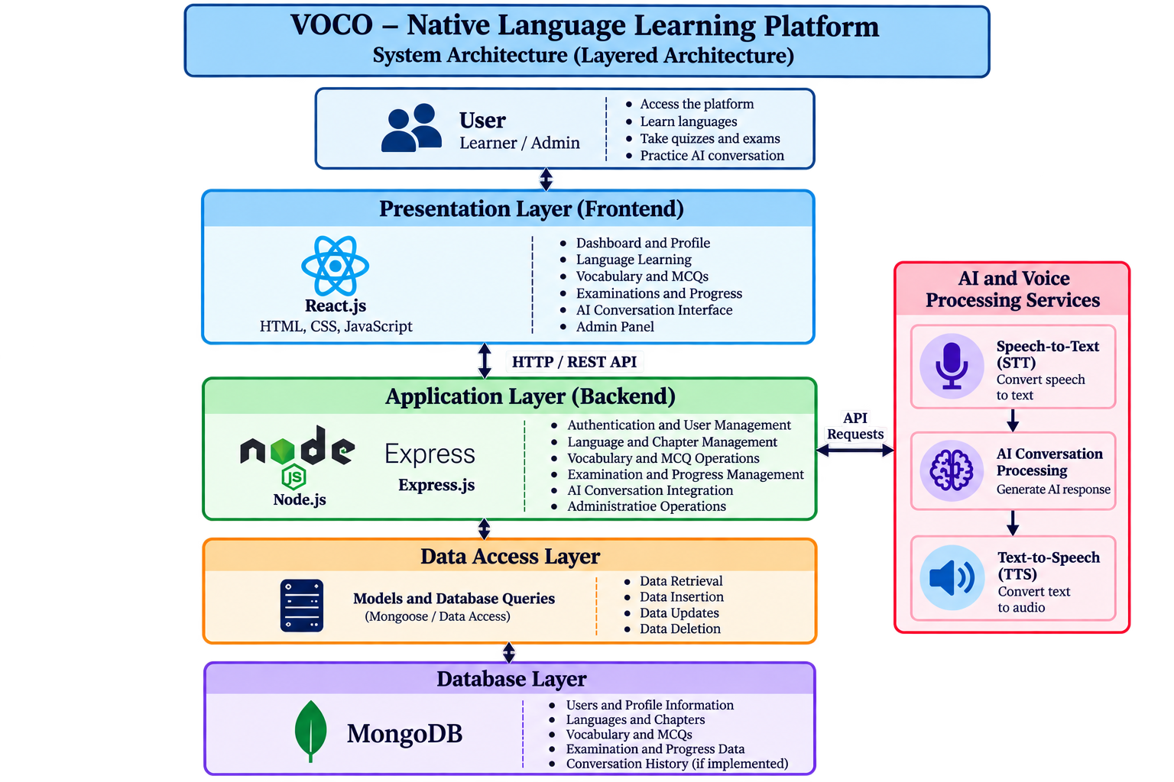
System Architecture (Layered, MERN)
Aa
अ
Request flow
React.js UI sends HTTP request
Express controllers run business logic
Mongoose models query MongoDB
Result returns to the UI
Voice: STT → AI response → TTS → playback
Aa
12
Notes:
Presenter: Yash Shah. Walk the original Sec 4.1.3 diagram top-down. Flow: React UI, HTTP/REST to Express, Mongoose models, MongoDB. AI path: speech to STT, AI response, TTS, audio played in frontend. Report names Ollama and Twilio only in the bibliography, so do not name an AI model.

Slide 13
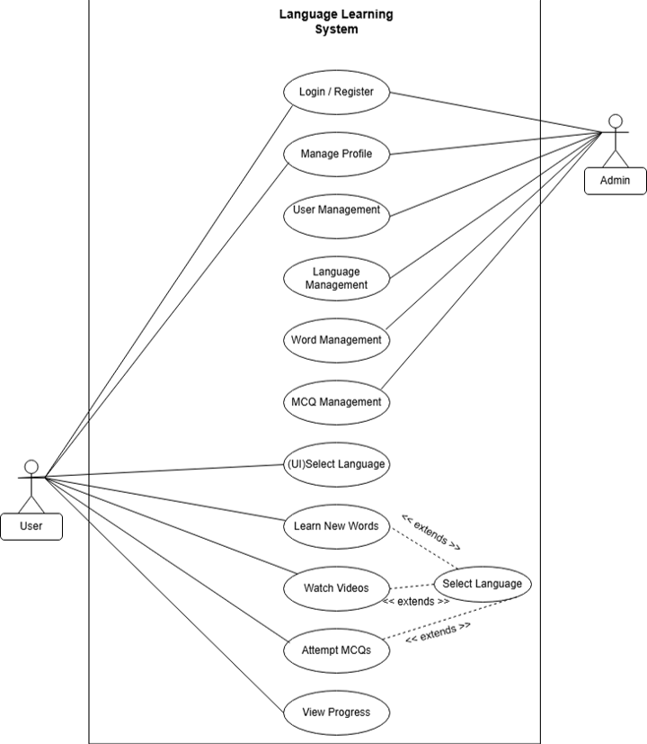
Use Case Diagram
અ
13
Notes:
Presenter: Krishna. Original diagram from Sec 4.3, unmodified. Actors: User and Admin. User: Select Language, Learn New Words, Watch Videos, Attempt MCQs, View Progress. Admin: User, Language, Word and MCQ management. Both: Login/Register and Manage Profile.

Slide 14
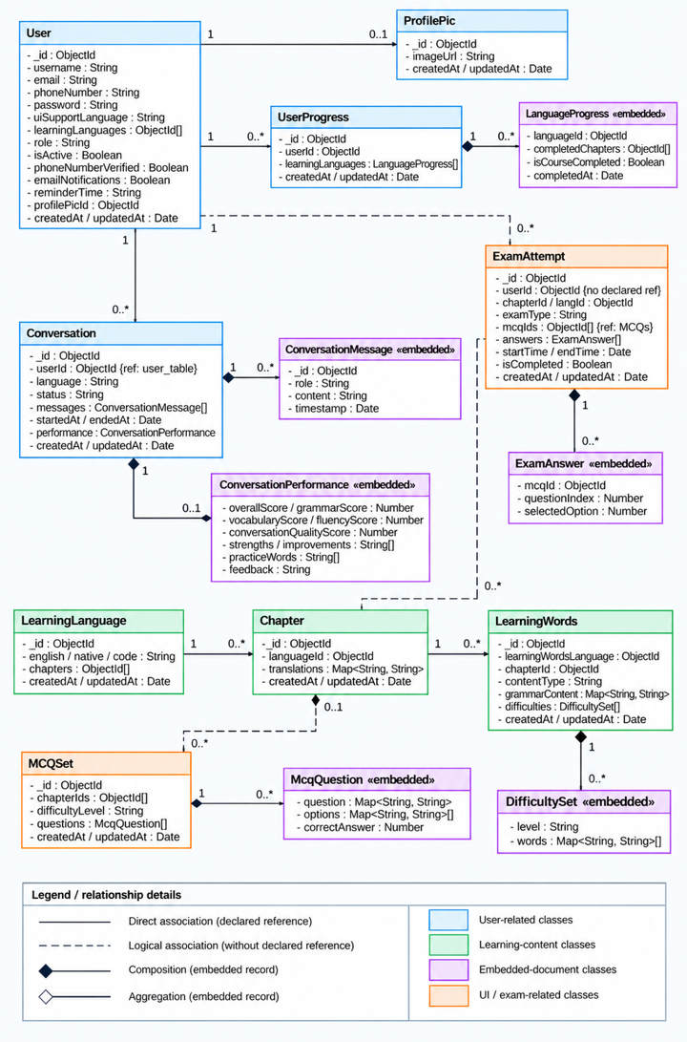
Class Diagram
14
Notes:
Presenter: Krishna. Sec 4.4 original. Colour groups: user, learning content, embedded documents, UI/exam. Key links: User 1—0..* Conversation, UserProgress; LearningLanguage 1—0..* Chapter 1—0..* LearningWords; MCQSet linked to Chapter; ExamAttempt with embedded ExamAnswer.

Slide 15
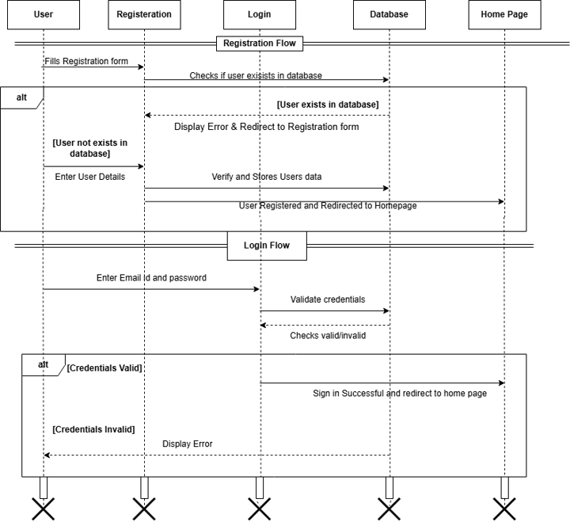
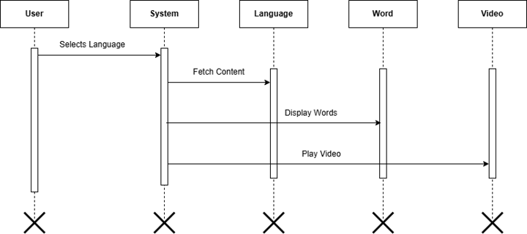
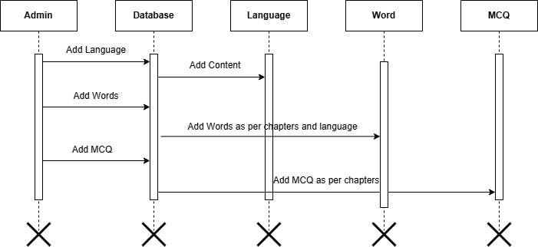
Interaction Diagrams
Aa
अ
Aa
Registration/login | Language content | Admin content
15
Notes:
Presenter: Krishna. Sec 4.5 originals: (1) registration and login with alt branches for existing user and valid/invalid credentials; (2) language selection fetching words and video; (3) admin adding language, words and MCQs by chapter.

Slide 16
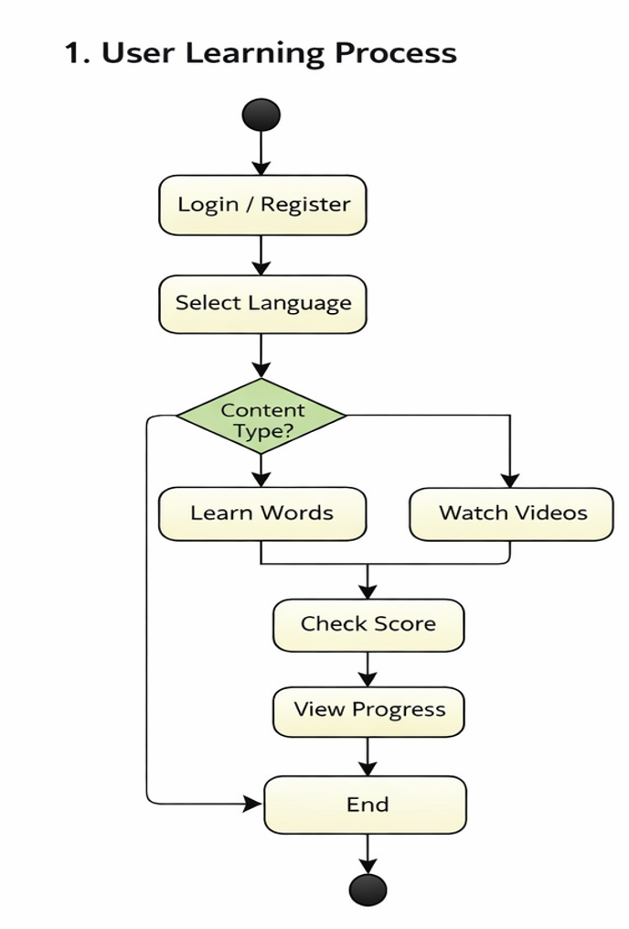
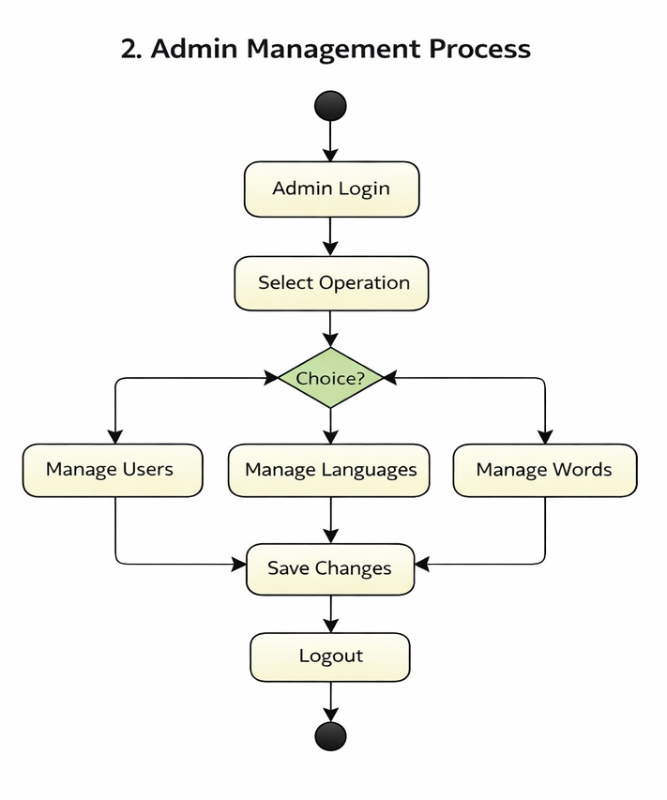
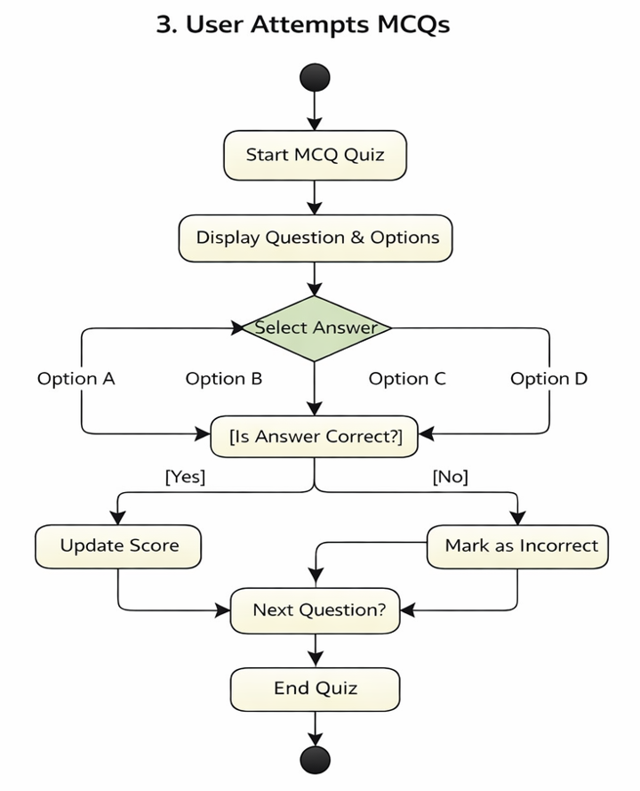
Activity Diagrams
Aa
अ
અ
16
Notes:
Presenter: Krishna. Sec 4.6 originals: user learning process (content-type decision), admin management process (choice of users, languages, words), and MCQ attempt (correct/incorrect scoring loop).

Slide 17
Database Design and Data Dictionary
Aa
अ
Collection | Purpose
user_tables | Accounts, roles, learning preferences
profilepics | Profile picture URL
learning_languages / chapters | Languages and multilingual chapters
learningwords | Vocabulary and grammar with difficulty
MCQ / ExamAttempt | Questions; chapter and final attempts
UserProgress | Completed chapters, course completion
conversations | AI sessions, messages, performance
ui_language_tables | UI translations (i18n)
Integration
Express controllers call Mongoose models
Conversation history is stored in MongoDB (report notes it as planned in the October status report)
अ
17
Notes:
Presenter: Meet. Sec 4.7 lists 10 collections. Mongoose models are used by the data access layer. Relationships follow the class diagram.

Slide 18
SOLID Principles & Refactoring
Aa
अ
Documented refactoring changes and the responsibilities they separate
CODE AREA
CHANGE MADE
INTENDED BENEFIT
18
Exam attempt creation
ExamAttemptController delegates creation to ExamAttemptFactory.
Separate creation from controller responsibilities.
18
Chapter + progress retrieval
LearnChapterFacade coordinates chapter content and user-progress retrieval.
Centralize retrieval and support concurrent independent requests.
18
Content update behavior
LearningWordsController uses getContentStrategy() for TextBlock / TextArea updates.
Separate content-specific update rules.
Aa
18
API response caching
ApiCache.js centralizes TTL expiry and cache invalidation.
Reuse cache behavior across consuming modules.
Refactoring focus: separation of responsibilities, maintainability, readability and reuse.
18
Source: PMDP Documentation, Section 5.2 and Refactoring Log.

Slide 19
Code Smells Identified & Refactored
Aa
अ
Four documented entries; each is recorded as medium severity
CODE SMELL / LOCATION
REFACTORING CHANGE
DOCUMENTED IMPACT
God Class
ExamAttemptController.js
Attempt initialization moved to ExamAttemptFactory.js.
Reduced controller responsibilities.
MED
God Class
LearnChapter.js
Chapter/progress retrieval moved to LearnChapterFacade.js.
Supports concurrent independent requests.
MED
Shotgun Surgery
ApiCache.js
Cache operations centralized with TTL and invalidation.
Reusable behavior across modules.
MED
અ
Duplicated Logic
LearningWordsController.js
TextBlock / TextArea rules separated via getContentStrategy().
Content-specific updates easier to maintain.
MED
Impacts are qualitative; no before/after numerical metrics are provided in the documentation.
Source: PMDP Documentation, Refactoring Log.
19

Slide 20
Design Pattern Implementation
Aa
अ
Pattern mapping documented for VOCO backend and API access
PATTERN
IMPLEMENTATION
ROLE IN VOCO
Factory
ExamAttemptFactory.js
Creates exam attempts; controller delegates creation.
CREATIONAL
Facade
LearnChapterFacade.js
Coordinates chapter content and progress retrieval.
STRUCTURAL
Proxy-style cache
ApiCache.js
Cache lookup, TTL expiry and invalidation.
STRUCTURAL
अ
Strategy
LearningWordsController.js
Selects TextBlock or TextArea update behavior.
BEHAVIORAL
Singleton-style client
apiClient.js
Exports one configured Axios instance for shared use.
CREATIONAL STYLE
Trade-offs: cache expiry/invalidation is required; shared modules need clear ownership and consistent use.
20

Slide 21
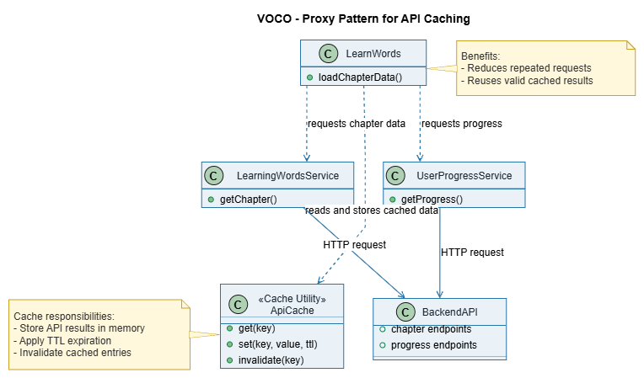
21

Slide 22
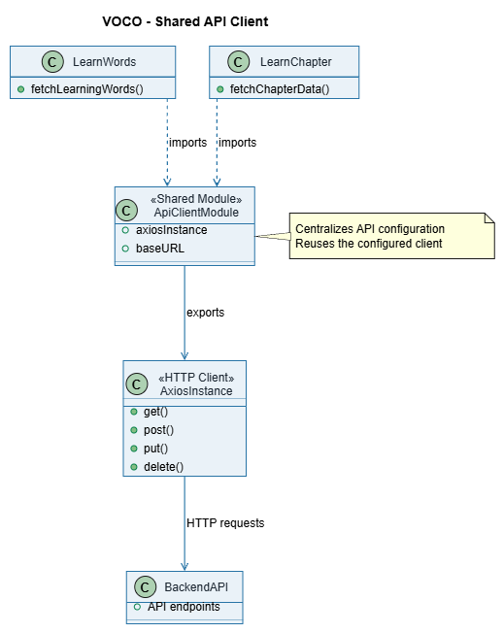
22

Slide 23
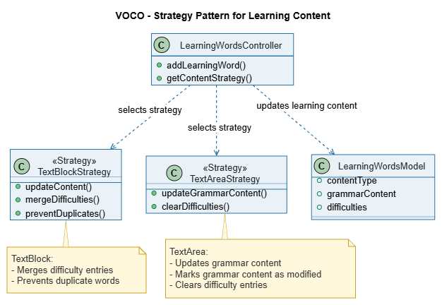
23

Slide 24
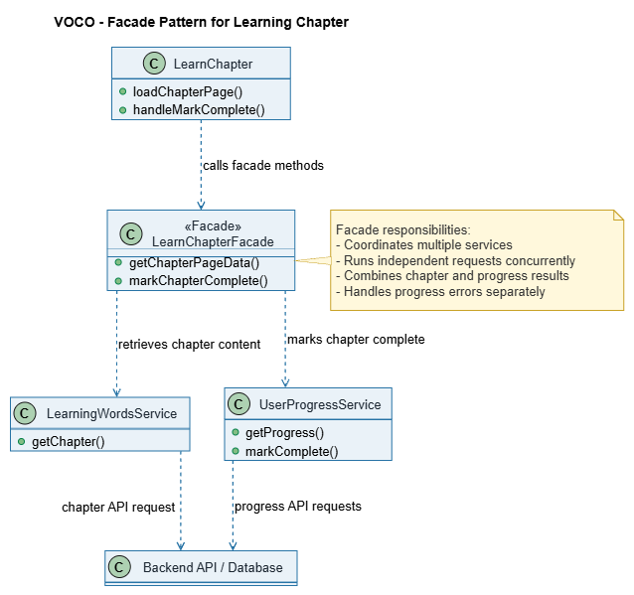
24

Slide 25
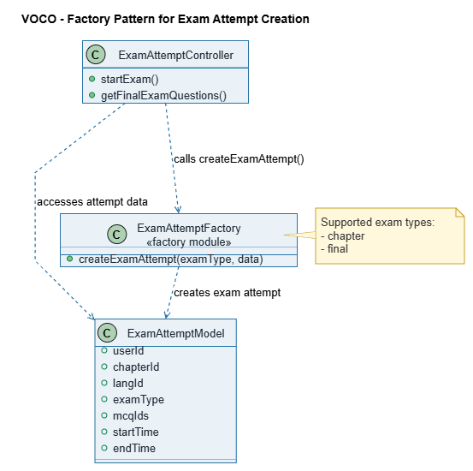
25

Slide 26
Testing – Documented Results
Aa
अ
ID | Test case | Steps | Result
101 | User registration (OTP) | 6 | 5 Pass, 1 Fail
102 | User login (JWT) | 5 | 5 Pass
103 | Learning words | 4 | 3 Pass, 1 Fail
104 | MCQ module | 4 | 4 Pass
105 | Chapter exam | 4 | 4 Pass
106 | Final exam | 3 | 2 Pass, 1 Fail
Recorded failures
101: duplicate phone/email still registered
103: invalid word data crashed page
106: final exam allowed without completing chapters
Fix status not confirmed in report
Aa
26
Notes:
Presenter: Krishna (QA). Sec 6.7: 6 test cases, 26 steps, 23 Pass, 3 Fail. The report does not confirm whether the failures were fixed. Test dates in the report (Mar-Apr 2026) precede the Aug-Oct schedule: mention if asked.

Slide 27
Testing – Documented Results
Aa
अ
Recorded test-step outcomes from the project documentation
FAILED TEST CASES
TEST EXECUTION SUMMARY
101
Duplicate phone/email registration was accepted.
23
Registration validation
test steps documented
103
Invalid word data caused a page crash.
23 passed
3 failed
Input validation / error handling
Aa
88.5% passed • 11.5% failed
106
Final exam was accessible before all chapters were completed.
The documentation does not confirm whether the failed cases were later resolved.
Exam access control
Re-test these cases before final deployment verification.
27
Source: PMDP Documentation, Testing section. Failure resolution is not confirmed in the report.

Slide 28
Jira Tracking – VOCO Scrum Board
Aa
अ
Key | Epic | Owner | Status | Done
VOCO-1 | User and Profile Mgmt | Meet | Done | 4/4
VOCO-2 | Learning Content, Vocabulary | Meet | Done | 5/5
VOCO-3 | MCQ and Examination | Meet | In Review | 5/5
VOCO-4 | AI Conversation and Speech | Yash | In Progress | 4/4
VOCO-5 | UI/UX and Frontend | Yash | In Review | 5/5
VOCO-6 | Quality, Patterns, Docs | Krishna | In Progress | 4/5
Board facts
Issues VOCO-7 to VOCO-54 (48)
Story points 1,2,3,5,8,13
176 SP planned, 171 SP Done
Open: VOCO-54 final testing, deployment, docs (5 SP, To Do)
Product Owner: project guide
અ
Workflow: To Do → In Progress → In Review → Done
28
Notes:
Presenter: Meet (Scrum Master). Data comes from Sec 6.8 tables; the report has no Jira screenshots, so this is a table recreation of documented data. Epics VOCO-3/5 show In Review, VOCO-4/6 In Progress with 4/4 and 4/5 stories. Flag: VOCO-4 shows 4/4 stories yet In Progress.

Slide 29
Sprint Progress – Story Points
Aa
अ
Reading it
176 SP total, 171 Done
Sprints 1–11 fully Done
Peak: Sprint 11, 29 SP (AI pipeline)
No daily burndown data in report
અ
29
Notes:
Presenter: Meet. The report has no burndown or earned-value data. These are story points per sprint summed from the Product Backlog (3.6/6.8.3). Sprint 12: 16 of 21 SP Done; VOCO-54 (5 SP) is To Do.

Slide 30
Sprint Progress & Burndown
Aa
अ
Recorded summary across the 12-sprint tracking record
STORY POINTS PLANNED
MARKED DONE
STORY POINTS REMAINING
COMPLETION
176
176
0
100%
Total recorded plan
All planned work completed
No work remaining
176 of 176 points
Overall story-point completion
176 completed
अ
0 remaining
Burndown evidence
All sprint tasks are complete. Actual remaining work at completion: 0 story points. The sprint burndown therefore finishes at zero.
i
Source: Final completion status confirmed by the project team.
30

Slide 31
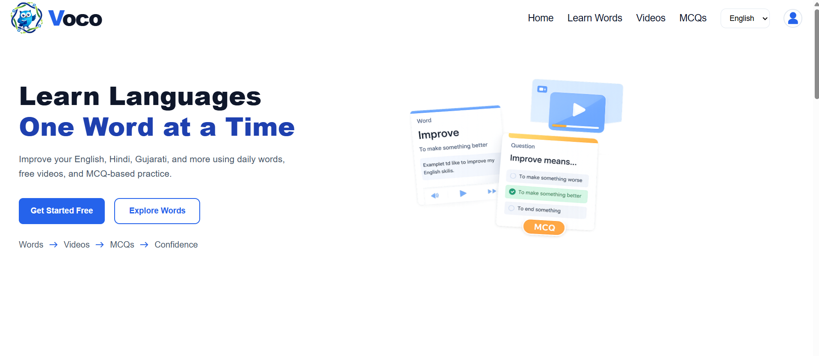
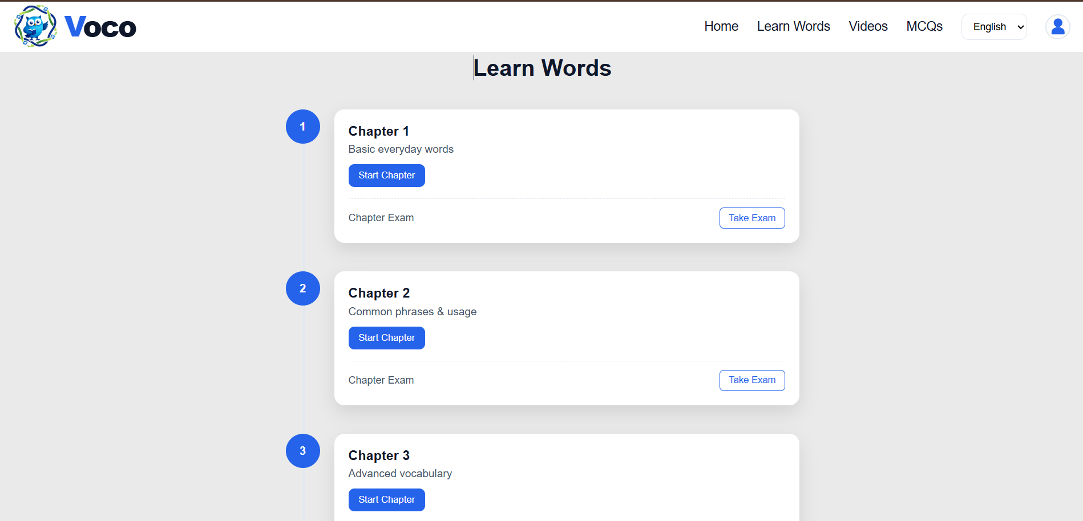
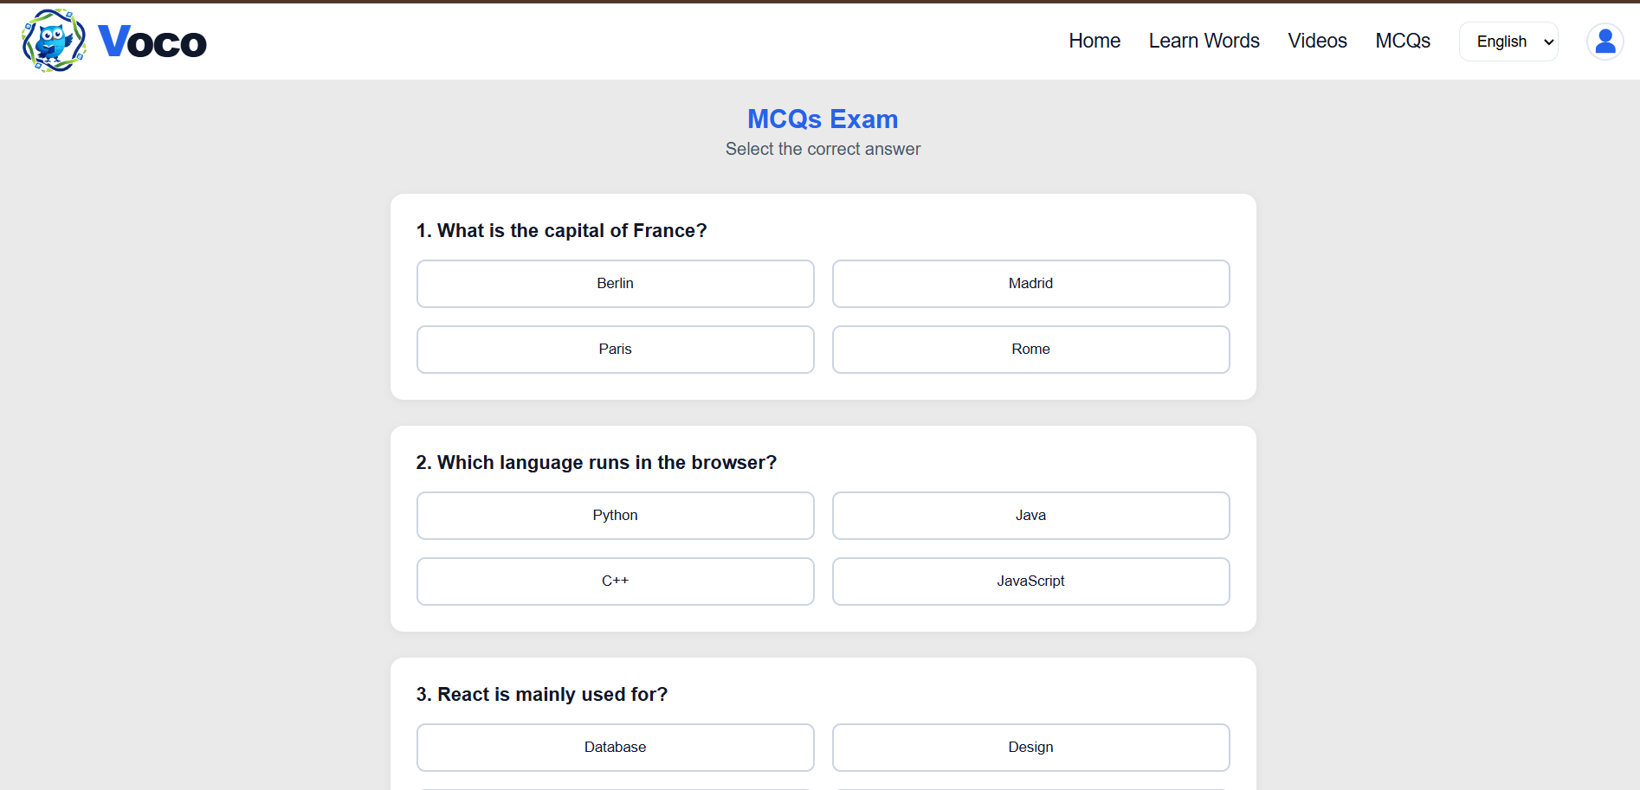
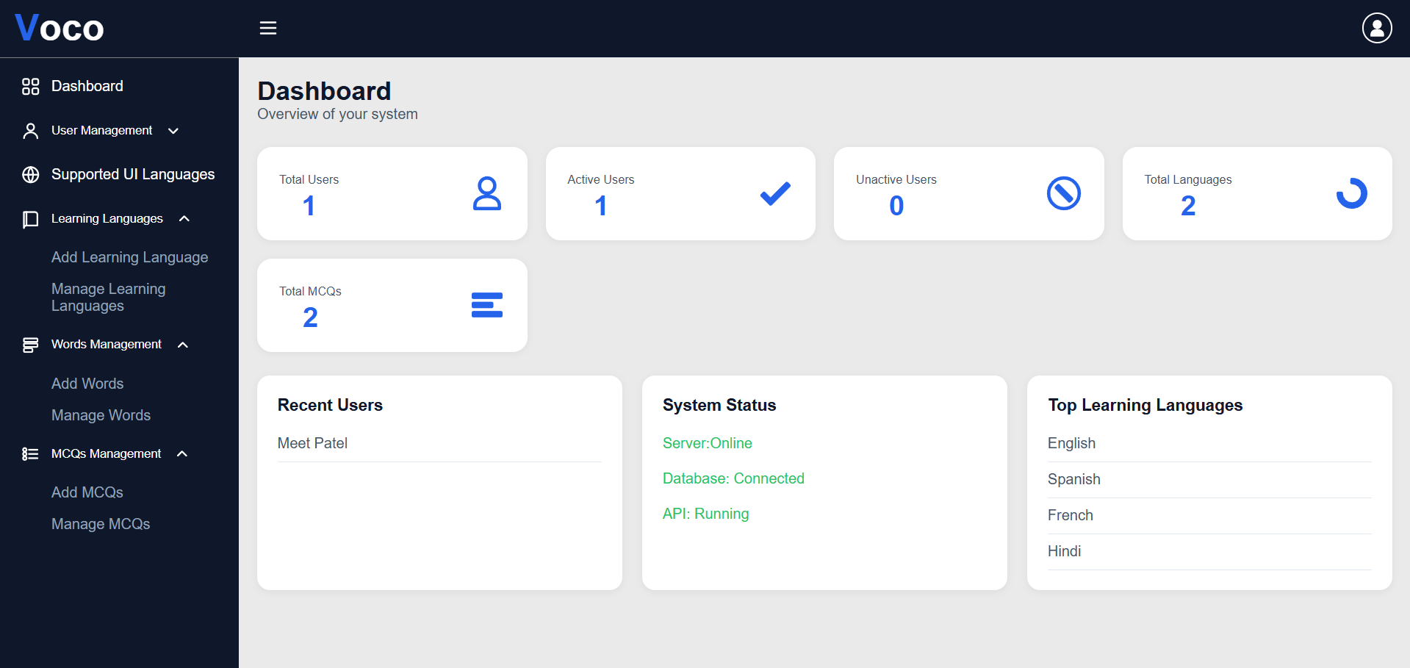
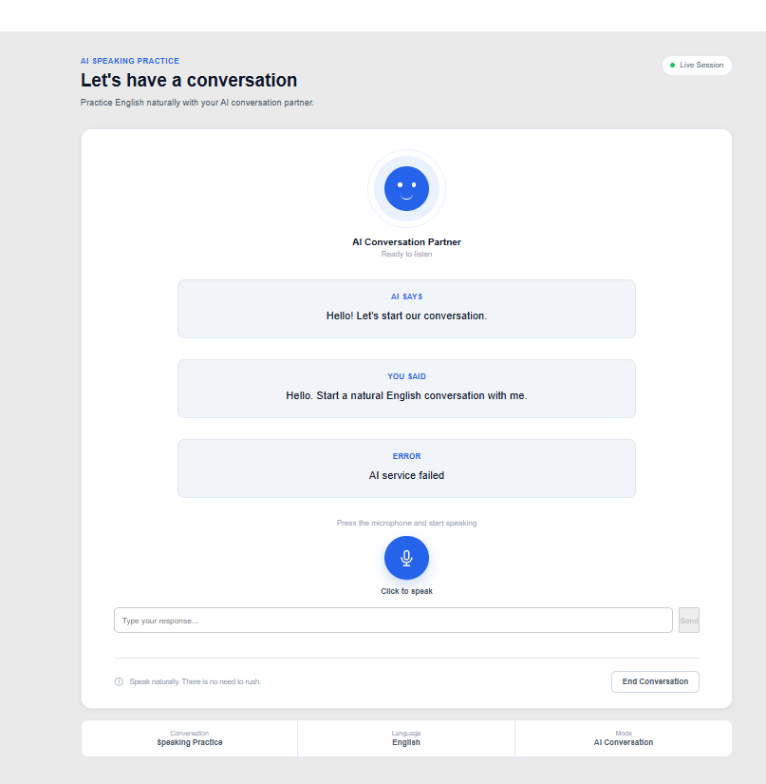
Live Demonstration
Aa
अ
1 Home
2 Learn Words
3 MCQ exam
Also: login/OTP, progress, admin
Admin add language, words, MCQs
અ
4 Dashboard
5 AI conversation
31
Notes:
Presenter: Yash Shah. Demo order: Home, Sign In/OTP, Learn Words, MCQ exam, Dashboard, AI Conversation. Only demo AI conversation if it runs in the current build; report marks the pipeline integrated and tested in Sprint 12.

Slide 32
Future Scope
Aa
अ
Proposed (Sec 6.10)
More natural, context-aware AI conversation
Lower STT / TTS latency
Advanced learning analytics
Personalized learning
More languages and assessments
Also noted
Mobile app support (conclusion)
Conversation history and evaluation: described as planned in October status report
Failed test cases to be re-verified
अ
32
Notes:
Presenter: Krishna. Sec 6.10. These are proposals, not delivered. Mobile app support is mentioned in the conclusion as potential.

Slide 33
Conclusion and Outcomes
Aa
अ
What we delivered
MERN platform: auth, learning, MCQs, exams, progress, admin
Layered architecture; 10 MongoDB collections
STT-AI-TTS voice pipeline integrated
171 of 176 SP Done across 12 sprints
Engineering outcomes
UML set: use case, class, interaction, activity
4 refactorings; 5 patterns
Tests: 23 of 26 steps passed
Open: final testing and deployment
Aa
33
Notes:
Presenter: Yash Shah. Summarize without claiming user growth or production performance. Report status: Partially Completed, final verification required.

Slide 34

અ
अ
Thank You
VOCO – Native Language Learning Platform
Aa
Aa
34
Notes:
All presenters. Be ready to defend: architecture, 4 refactorings, 5 patterns, 23/26 tests, Sprint 12 status.

